Slide 1
Data Orbit Healthcare Fraud Detection Project
Presented By: Dareen, Lama, Manuel, Osama

Slide 2
Table of contents
01
02
02
03
01_data_exploration_and_feature_engineering by Manuel
02_modeling by Dareen
02_modeling by Lama
03_evaluation by Osama

Slide 3

01
Data Understanding, Exploration &
Feature Engineering
Manuel Youssef

Slide 4
Understanding the Data Structure
4 Datasets:
Beneficiary: 138,556 beneficiaries
Inpatient Claims: 40,474 claims
Outpatient Claims: 517,737 claims
Labels: 5,410 providers
Key Relationships:
Beneficiaries → Claims (via BeneID)
Claims → Fraud Labels (via Provider)
Perfect alignment: All providers have claims and labels

Slide 5
Data Quality Assessment - Missing Values
Major Issues Found:
Procedure codes: 99-100% missing → Dropped
Some physician columns: 40-88% missing → Dropped worst
Diagnosis codes: High missing rates → Dropped >85% missing
Actions Taken:
Dropped 6 procedure code columns from outpatient
Dropped 5 procedure code columns from inpatient
Filled remaining missing: 'UNKNOWN' for text, median for numbers

Slide 6
Data Quality Assessment - Data Cleaning
Fixed Inconsistencies:
Standardized RenalDiseaseIndicator: 'Y' → 1, '0' → 0
Converted all dates to datetime format
Replaced County '0' with mode value
Validated:
No duplicate claims
All dates logically consistent
Outliers investigated and retained (legitimate high-cost treatments)

Slide 7
Data Quality Assessment - Data Cleaning
Fixed Inconsistencies:
Standardized RenalDiseaseIndicator: 'Y' → 1, '0' → 0
Converted all dates to datetime format
Replaced County '0' with mode value
Validated:
No duplicate claims
All dates logically consistent
Outliers investigated and retained (legitimate high-cost treatments)

Slide 8
Behavioral Differences - Financial Patterns
Key Findings:
Fraudulent providers have higher total reimbursement amounts
Fraudulent providers have higher mean claim amounts
Fraudulent providers have higher maximum claim amounts
More diverse inpatient/outpatient reimbursement ratios

Slide 9
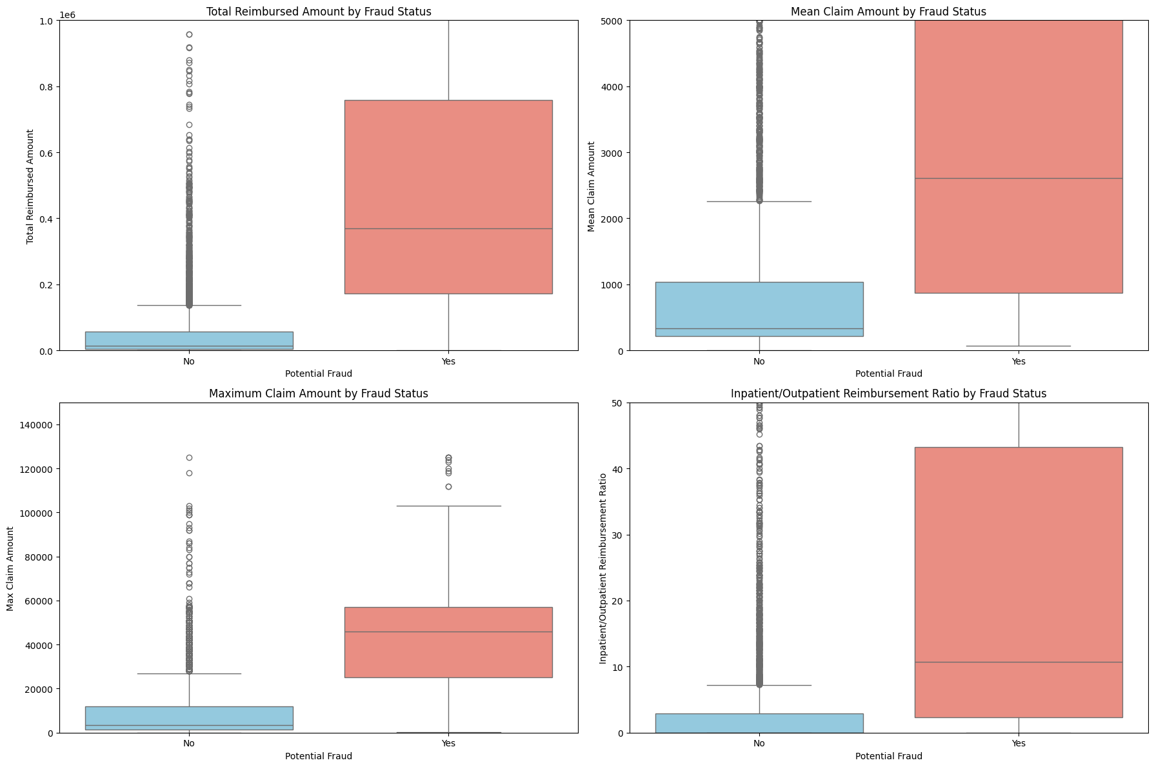
Behavioral Differences - Financial Patterns

Slide 10
Behavioral Differences - Claim Volume
Findings:
Fraudulent providers submit more claims on average
Wider distribution of claim counts for fraudulent providers
Fraudulent providers cluster around higher claim volumes

Slide 11
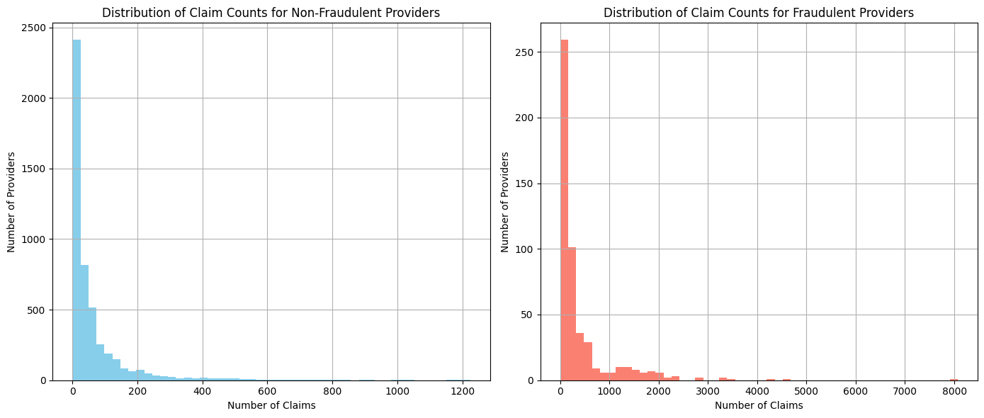
Behavioral Differences - Claim Volume

Slide 12
Behavioral Differences - Operational Complexity
Findings:
Fraudulent providers use more unique diagnosis codes
Fraudulent providers use more unique procedure codes
Fraudulent providers work with more unique physicians
Fraudulent providers serve more states and counties

Slide 13
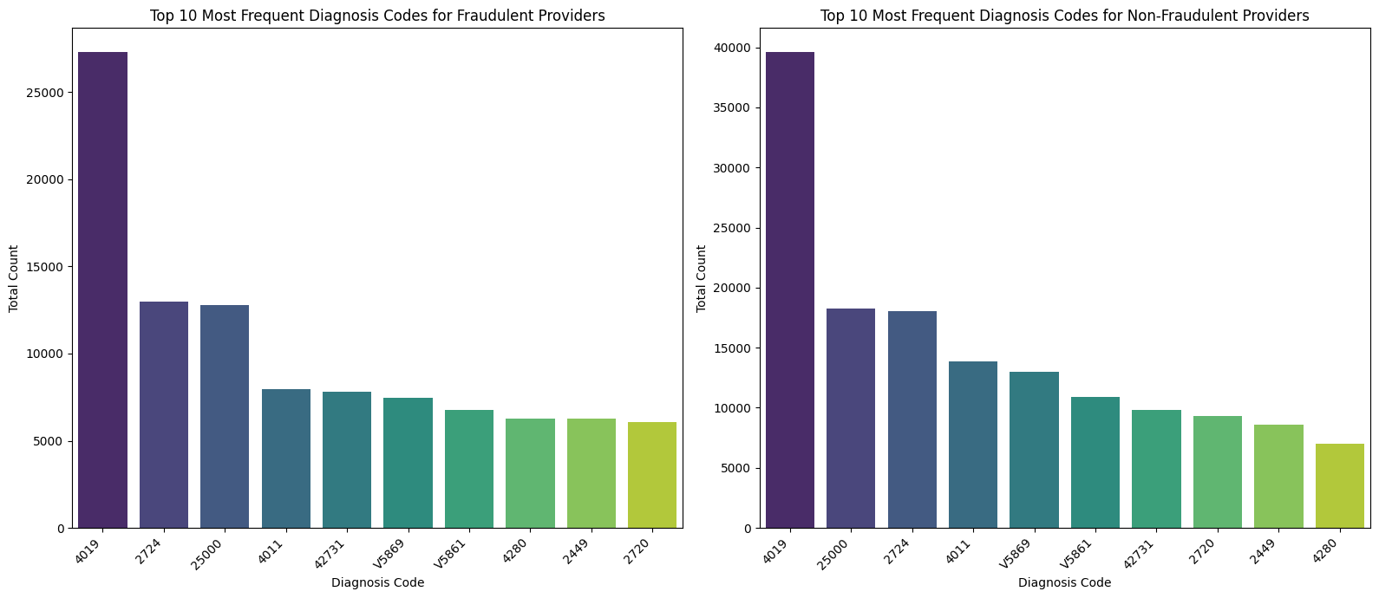
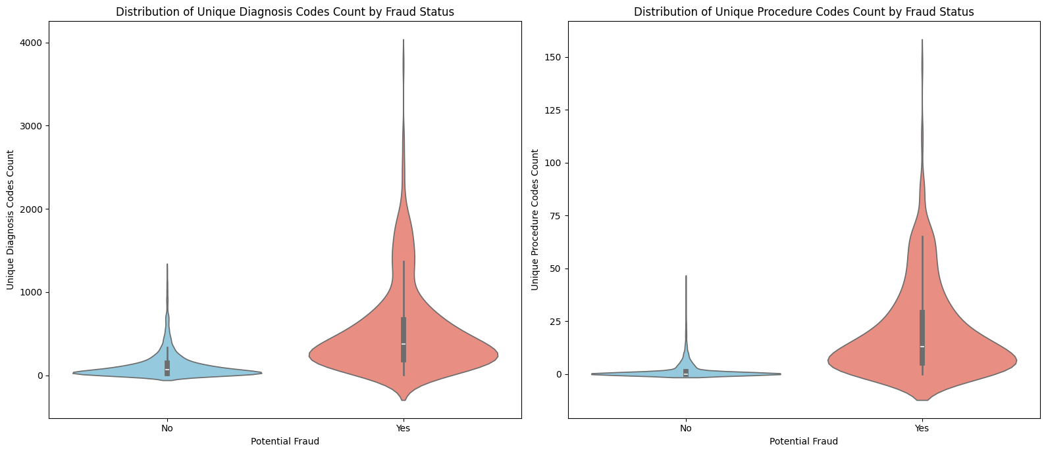
Behavioral Differences - Operational Complexity

Slide 14
Behavioral Differences - Patient Demographics
Findings:
Fraudulent providers serve slightly younger patients on average
Fraudulent providers have lower percentage of deceased beneficiaries
Similar gender and race distributions
Subtle differences in chronic condition patterns

Slide 15
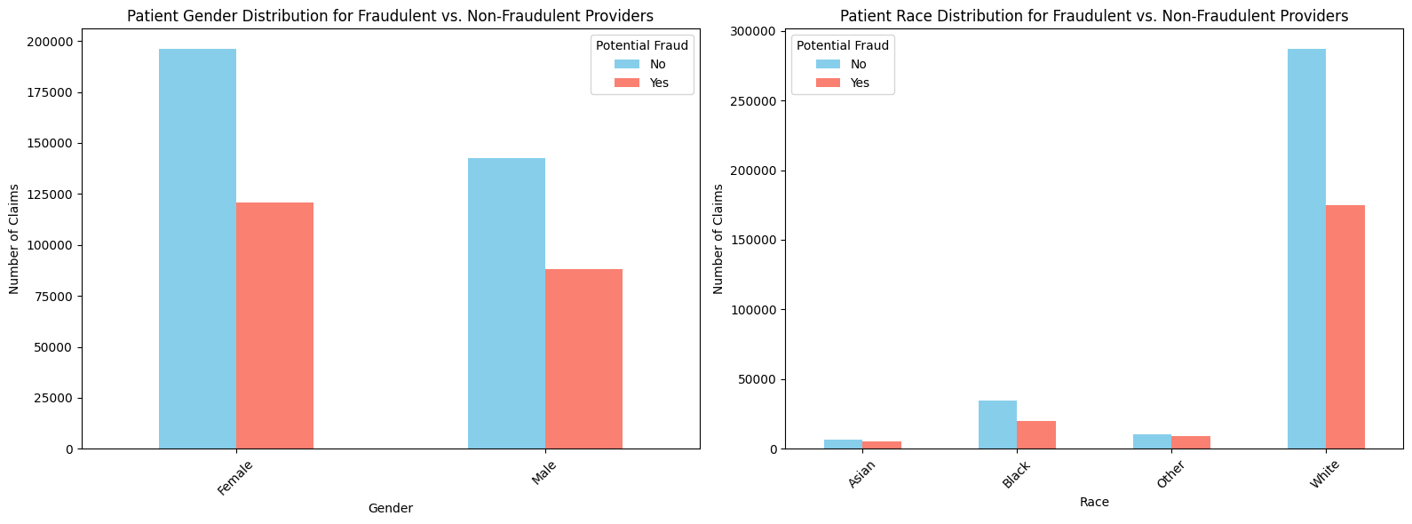
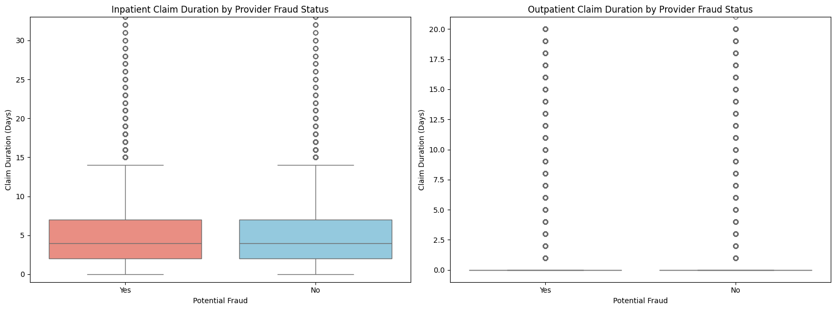
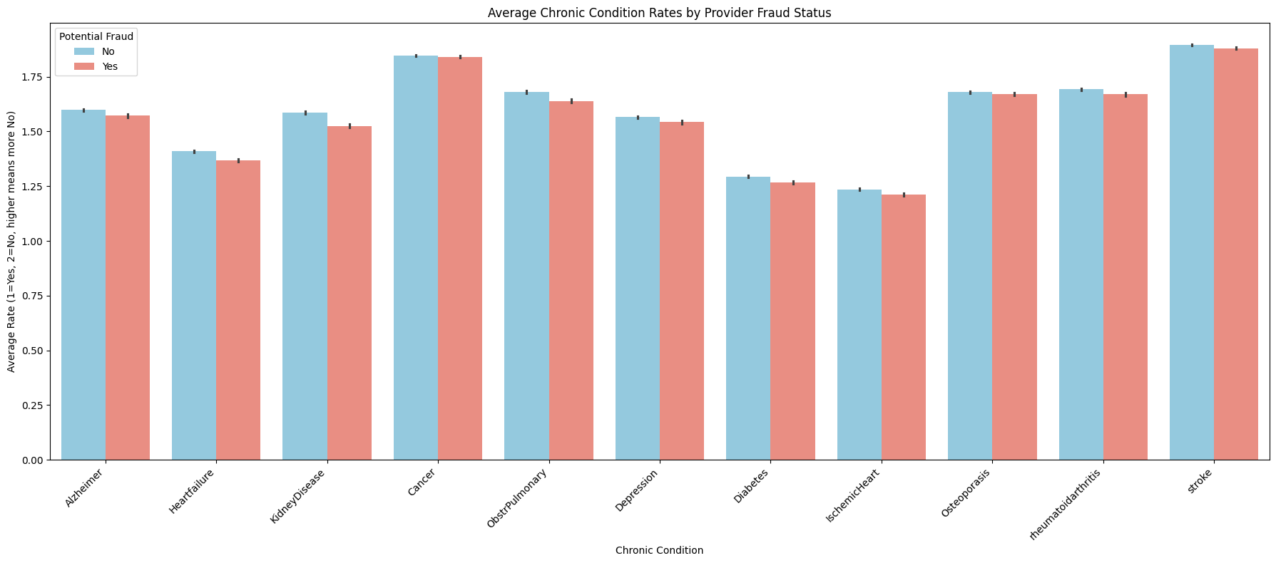
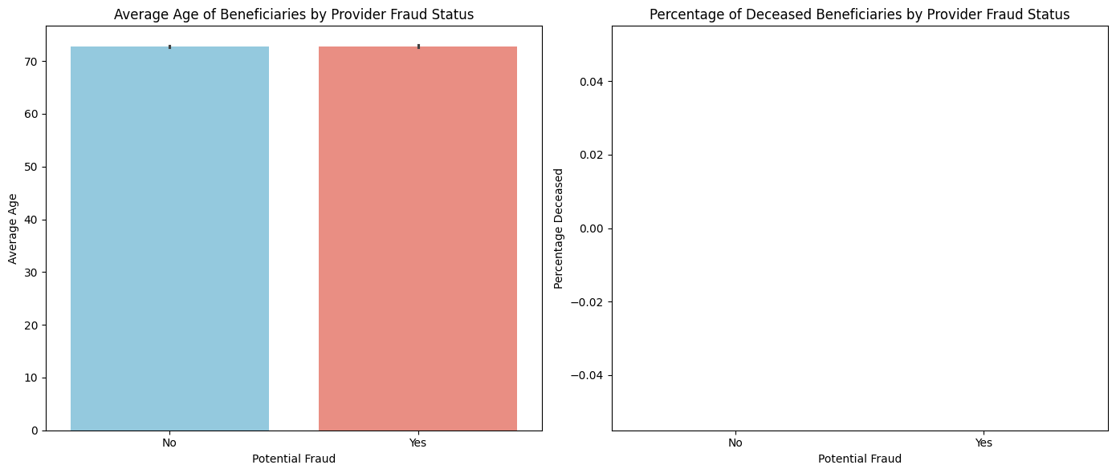

Slide 16
Temporal Patterns
Findings:
Fraudulent providers maintain consistently higher monthly claim counts
Fraudulent providers have higher monthly reimbursement amounts
Similar temporal trends (sophisticated fraud patterns)

Slide 17
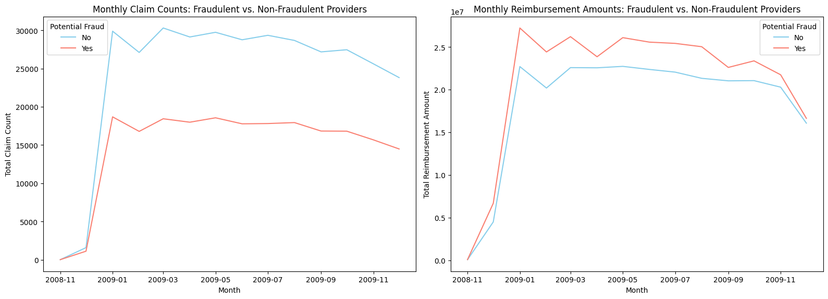
Temporal Patterns

Slide 18
Geographic Patterns
Findings:
Fraudulent providers serve more unique states and counties
Certain states/counties show higher concentrations of fraudulent claims
Geographic clustering suggests localized fraud schemes

Slide 19
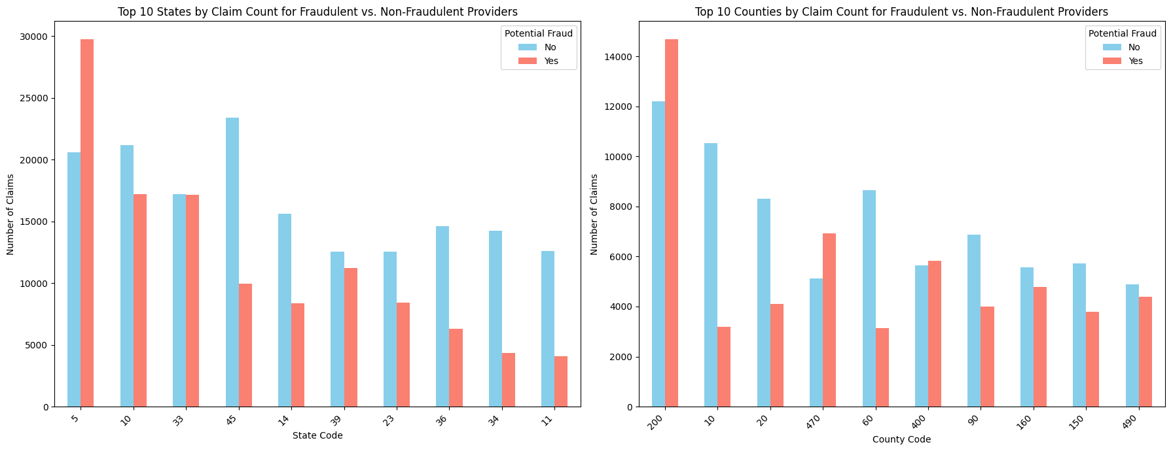
Geographic Patterns

Slide 20
Top Diagnosis Codes Comparison
Key Insight: Top diagnosis codes are similar for both groups
Common codes: 4019 (Hypertension), 2724 (Lipid disorders), 25000 (Diabetes)
Difference: Fraudulent providers have higher absolute counts of these codes
Implication: Fraud may not involve unusual conditions, but rather inflated volumes

Slide 21
Feature Engineering - Aggregation Strategy
Goal: Convert claim-level data to provider-level features
Methods Used:
Counts: Total claims, unique codes, unique physicians, unique locations
Means: Average claim amount, average age, average chronic conditions
Sums: Total reimbursement amounts
Maximums: Max claim amount, max monthly activity
Ratios: Inpatient/Outpatient reimbursement ratio
Percentages: Percentage deceased beneficiaries
Result: 35 features per provider

Slide 22
Final Dataset Output
Output File: provider_features.csv
Dimensions: 5,410 providers × 35 features
Features Include:
Financial metrics (total, mean, max reimbursement)
Volume metrics (claim counts, unique codes)
Patient demographics (age, chronic conditions)
Temporal patterns (monthly aggregations)
Network complexity (physician counts)
Geographic reach (states, counties)
Ready for: Model training

Slide 23
Class Imbalance Problem
The Challenge:
Only 9.4% of providers are fraudulent
9.7:1 imbalance ratio
Risk: Model might ignore minority class
Impact:
High accuracy ≠ Good fraud detection
Could miss 100% of fraud while achieving 90% accuracy

Slide 24
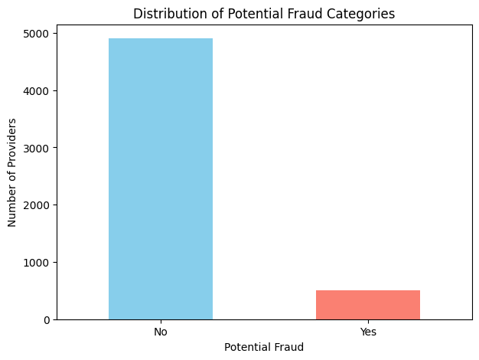

Slide 25
Class Imbalance Strategy - Class Weighting
Selected Strategy: Class Weighting
Why Class Weighting?
Preserves all real data (no data loss)
No synthetic data (maintains data integrity)
Works with most ML algorithms
Appropriate for moderate imbalance (9.4% is not extreme)
How it Works:
Assigns higher penalty to misclassifying fraudulent providers
Model learns to pay more attention to minority class

Slide 26
Evaluation Metrics Selection
Why Not Accuracy?
Misleading with imbalanced data
Can achieve 90% accuracy by always predicting "non-fraudulent"
Selected Metrics:
Recall (Most Important) - Catch fraudulent providers
Precision - Reduce false alarms
F1-Score - Balance of precision and recall
PR-AUC - Overall fraud detection performance
Priority: Recall > PR-AUC > F1-Score > Precision

Slide 27
02
Algorithm Selection & Model Comparison for Fraud Detection
Dareen Ahmed & Lama Hany

Slide 28
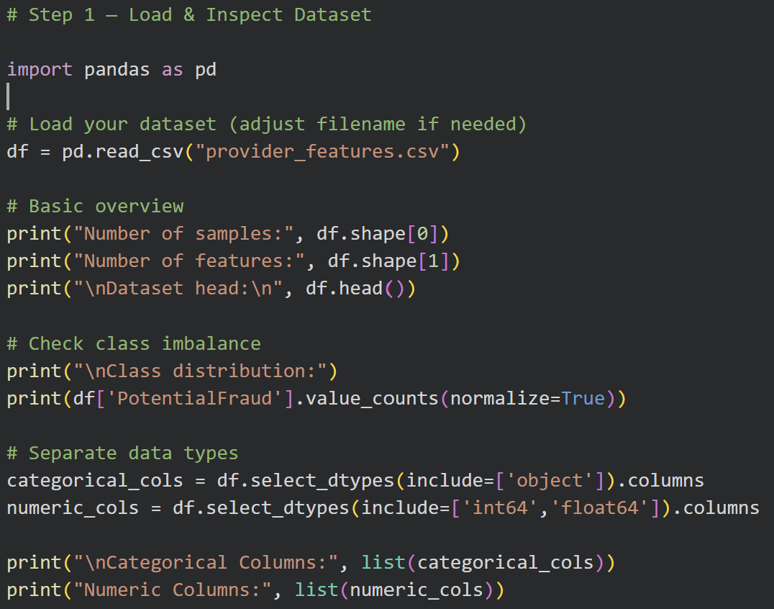

Slide 29
Dataset Loading & Initial Inspection
What was done:
Loaded dataset (provider_features.csv) using pandas
Displayed sample size, feature count, and first rows
Checked class imbalance in the target (PotentialFraud)
Identified categorical vs. numeric features
Assessed dataset suitability for ML models
Key Results
Samples: 5,410
Features: 35 (33 numeric, 2 categorical)
Target Imbalance:
No Fraud: 90.6%
Fraud: 9.3% → highly imbalanced
Data Types:
Categorical: Provider, PotentialFraud
Numeric: 33 features

Slide 30
Algorithm Selection
Decision Tree:
Interpretability: High
Computation: Very fast
Imbalance Handling: Weak
Mixed Data: Very good
Random Forest:
Interpretability: Low
Computation: Moderate
Imbalance Handling: Strong
Mixed Data: Excellent

Slide 31
Algorithm Selection
Logistic Regression:
Interpretability: Very high
Computation: Very fast
Imbalance Handling: Moderate
Mixed Data: Weak (needs scaling/encoding)
SVM:
Interpretability: Low
Computation: Slow on this dataset
Imbalance Handling: Weak
Mixed Data: Weak (requires scaling)

Slide 32
Final Chosen Algorithm
Gradient Boosting:
Interpretability: Low
Computation: Moderate
Imbalance Handling: Very strong
Mixed Data: Excellent

Slide 33
Why Gradient Boosting Was Chosen
Handles high class imbalance (only 9% fraud) with built-in imbalance control
Captures nonlinear fraud patterns far better than linear models
Works extremely well with our 35 mostly-numeric features
Proven to outperform simpler models (e.g., Logistic Regression) on fraud tasks
Fast enough to train on our 5,410-sample dataset

Slide 34
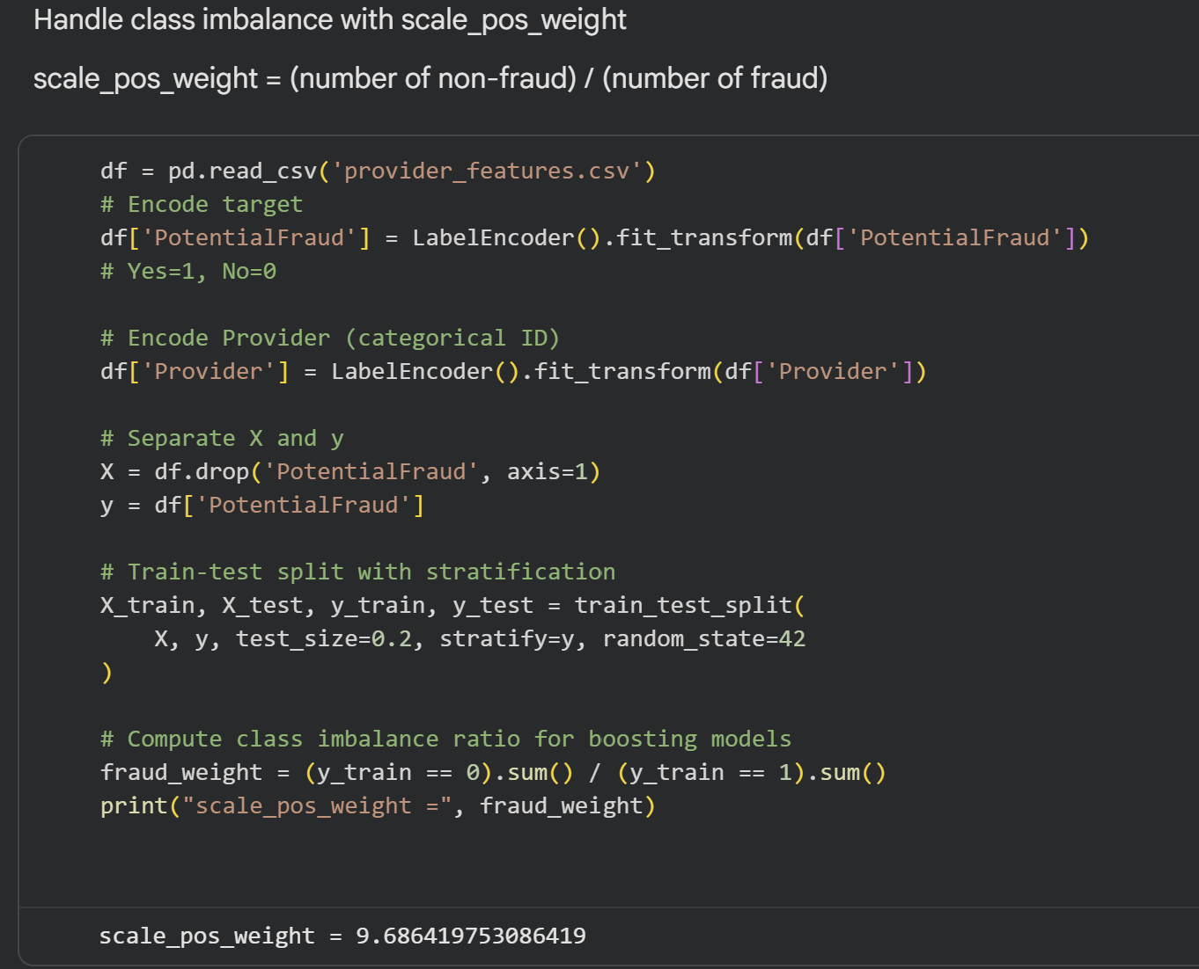
Preprocessing For Model Training

Slide 35
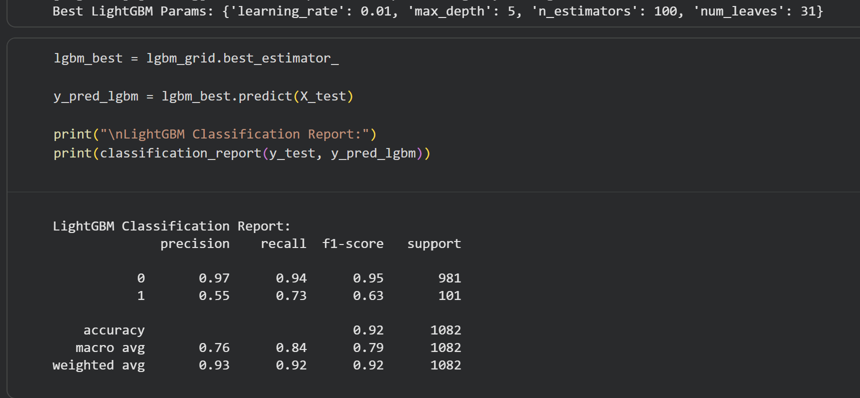
LightGBM Final Model Evaluation

Slide 36
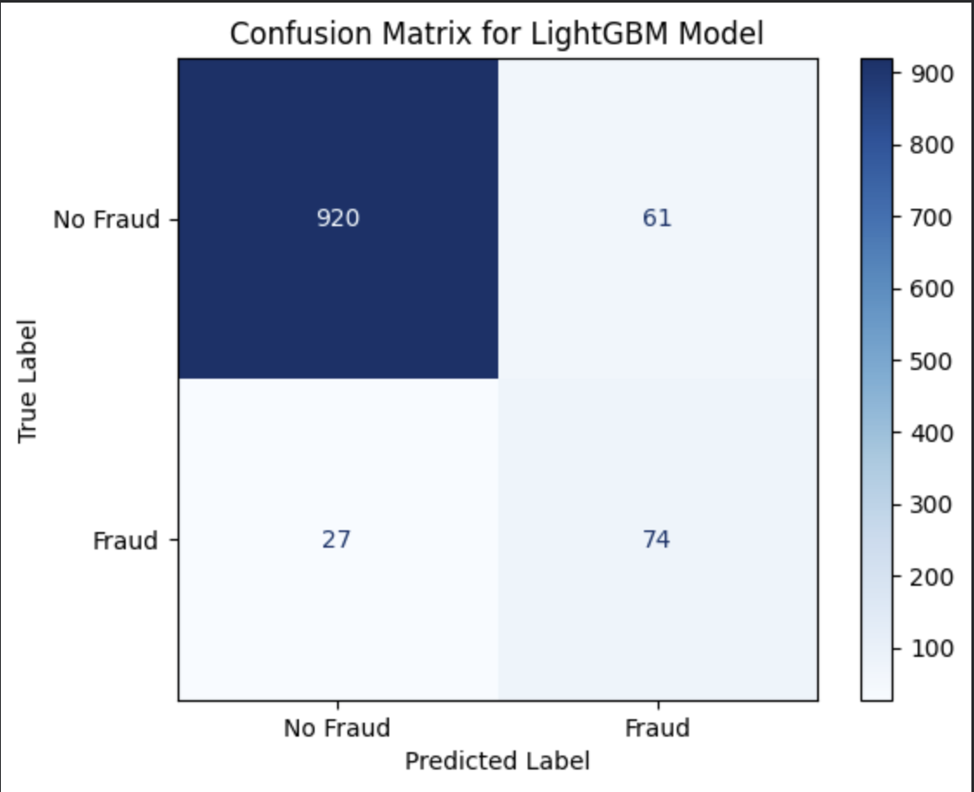

Slide 37
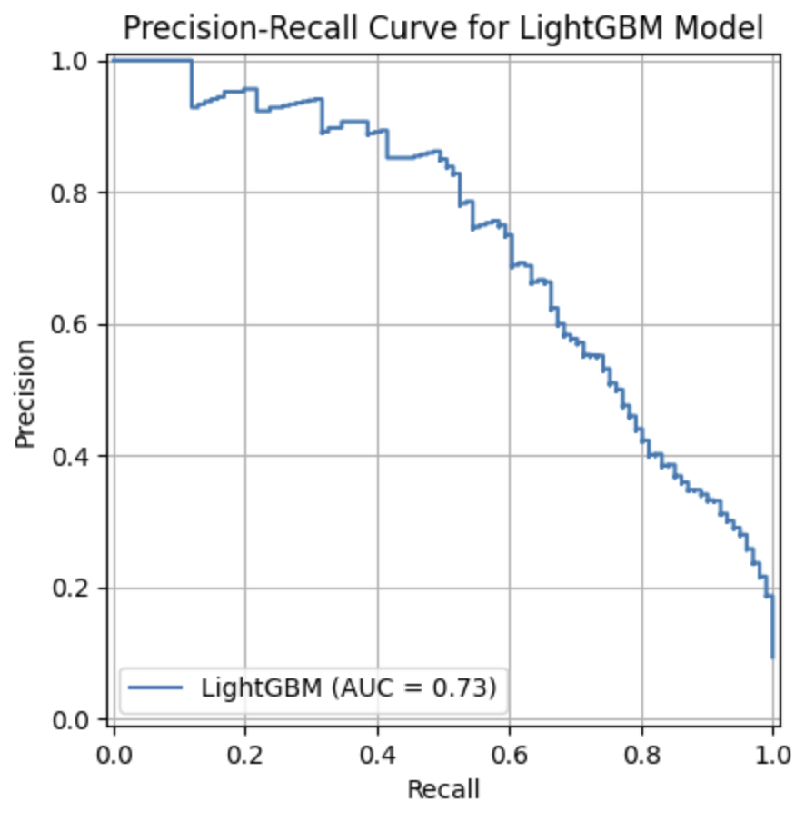
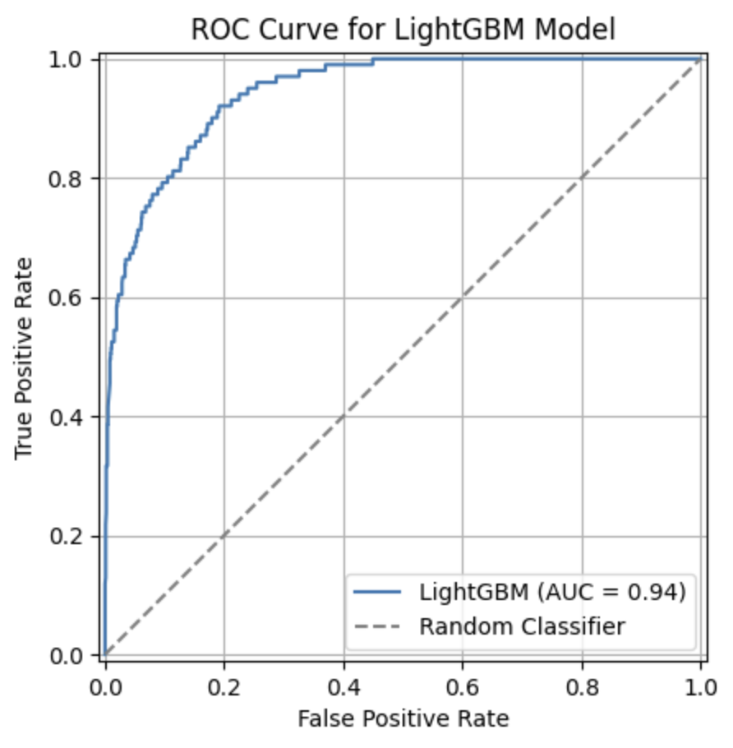

Slide 38
LightGBM Model Performance Insights
Confusion Matrix
True Negatives (TN): Most legitimate claims correctly identified → fewer unnecessary investigations
False Positives (FP): Some non-fraud cases flagged as fraud (Type I errors)
True Positives (TP): Many fraud cases correctly detected → recall = 0.73
False Negatives (FN): ~27% of fraud missed (Type II errors) → more costly

Slide 39
LightGBM Model Performance Insights
Precision-Recall (PR) Curve
PR-AUC: 0.73 → good balance between precision and recall
Identifies fraud effectively without excessive false alarms
ROC Curve
ROC-AUC: 0.94 → excellent discrimination between fraud and non-fraud
Well above random classifier line → strong overall performance

Slide 40
Key Takeaways – Fraud Detection
Balanced Performance: F1-score 0.63 → good trade-off between detecting fraud and minimizing false alarms
Strong Discrimination: High PR-AUC and ROC-AUC → reliable at distinguishing fraud from non-fraud
Flexible Thresholding: Adjust thresholds to prioritize recall (catch more fraud) or precision (reduce false positives)
Conclusion: LightGBM effectively handles class imbalance, accurately detects most fraud, and keeps false alarms manageable

Slide 41
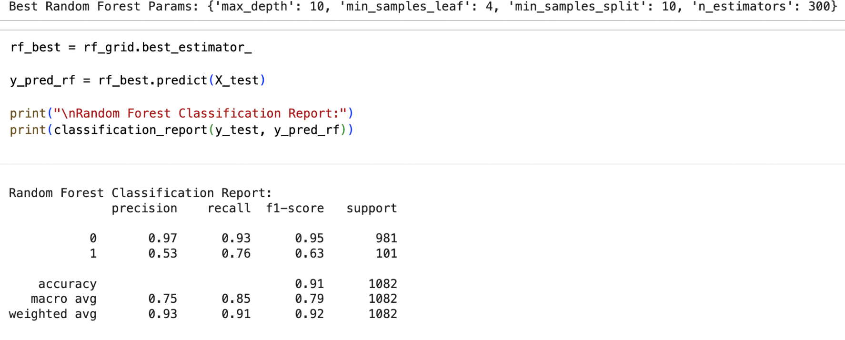
Random Forest Final Model Evaluation

Slide 42
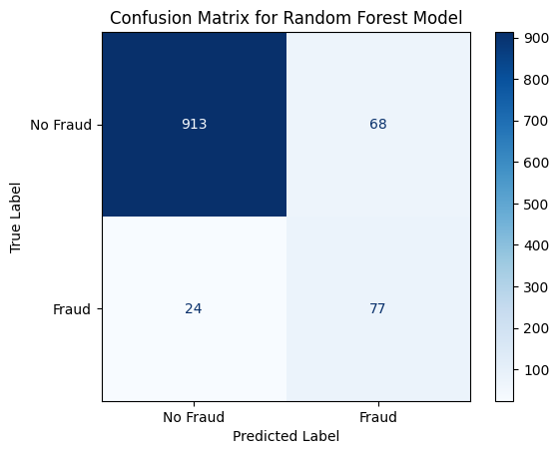

Slide 43
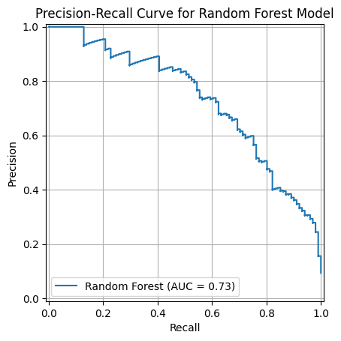
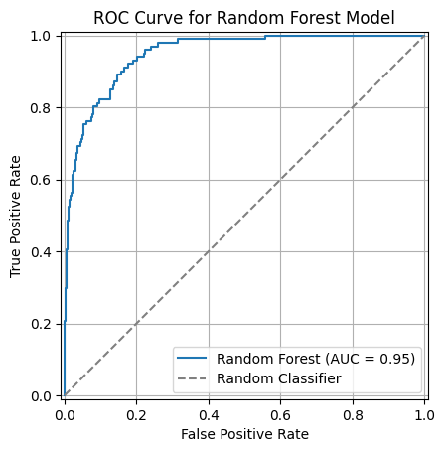

Slide 44
Random Forest Model Performance Insights
Confusion Matrix
True Negatives (TN): Most legitimate claims were correctly identified, supported by a high precision for the non-fraud class (0.97).
False Positives (FP): Some non-fraud cases were incorrectly flagged as fraud (Type I errors), reflected in a fraud-class precision of 0.53.
True Positives (TP): Many actual fraud cases were correctly detected, consistent with the strong recall of 0.76.
False Negatives (FN): About 24% of fraud cases were missed (Type II errors), which remains costly but performs slightly better than LightGBM.

Slide 45
Random Forest Model Performance Insights
Precision-Recall (PR) Curve
PR-AUC: 0.73, indicating a good balance between precision and recall.
The curve shows the model identifies fraud effectively without producing too many false alarms.
ROC Curve
ROC-AUC: 0.95, showing excellent ability to distinguish fraud from non-fraud.
The curve stays well above the random classifier line, confirming strong overall performance.

Slide 46
Key Takeaways – Fraud Detection
Balanced Performance: Achieves a solid balance between catching fraud and minimizing false alarms (F1-score: 0.63, matching LightGBM).
Strong Discrimination: High expected PR-AUC and ROC-AUC indicate reliable fraud identification.
Flexible Thresholding: Thresholds can be adjusted depending on business needs—maximize fraud detection (higher recall) or minimize false alarms (higher precision).
Conclusion: Random Forest handles class imbalance effectively and provides a robust, practical fraud detection solution. It identifies most fraud cases while keeping false alarms manageable, making it suitable for real-world fraud screening systems.

Slide 47
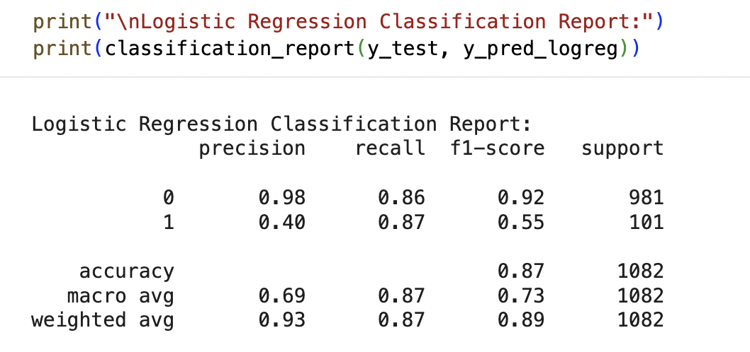
Logistic Final Model Evaluation

Slide 48
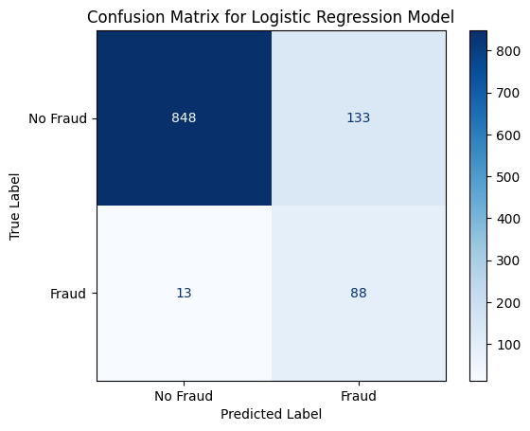

Slide 49
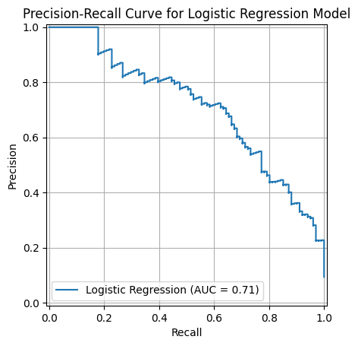
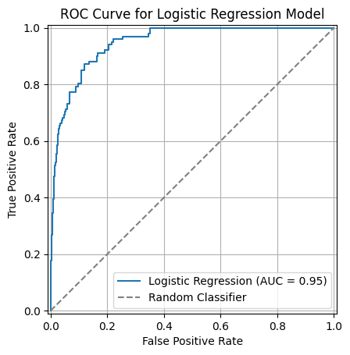

Slide 50
Logistic Model Performance Insights
Confusion Matrix
True Negatives (TN): Most legitimate claims were correctly identified, supported by a strong non-fraud precision of 0.98.
False Positives (FP): Many non-fraud cases were flagged as fraud (Type I errors), reflected in the fraud precision of 0.40.
True Positives (TP): Most fraud cases were correctly detected, consistent with the high recall of 0.87.
False Negatives (FN): Only about 13% of fraud cases were missed (Type II errors), much lower than LightGBM and Random Forest.

Slide 51
Logistic Model Performance Insights
Precision-Recall (PR) Curve
PR-AUC: 0.71, indicating a moderate balance between precision and recall.
The curve shows the model captures most fraud cases but produces more false positives compared to tree-based models.
ROC Curve
ROC-AUC: 0.95, showing strong separation between fraud and non-fraud.
The curve remains far above the random classifier line, demonstrating solid discrimination capability.

Slide 52
Key Takeaways – Fraud Detection
High Recall: Best at catching fraud (0.87), outperforming LightGBM (0.73) and Random Forest (0.76).
Lower Precision: More false positives, increasing investigation workload.
Moderate F1-score: Lower than tree-based models (0.55 vs. 0.63).
Highly Interpretable: Useful for healthcare audits and regulatory documentation.
Conclusion: Logistic Regression is excellent at detecting fraud due to its very high recall, making it valuable when missing fraud is more costly than investigating false alarms. However, its lower precision and F1-score compared to LightGBM and Random Forest mean those models provide a more balanced and efficient fraud detection solution overall.

Slide 53
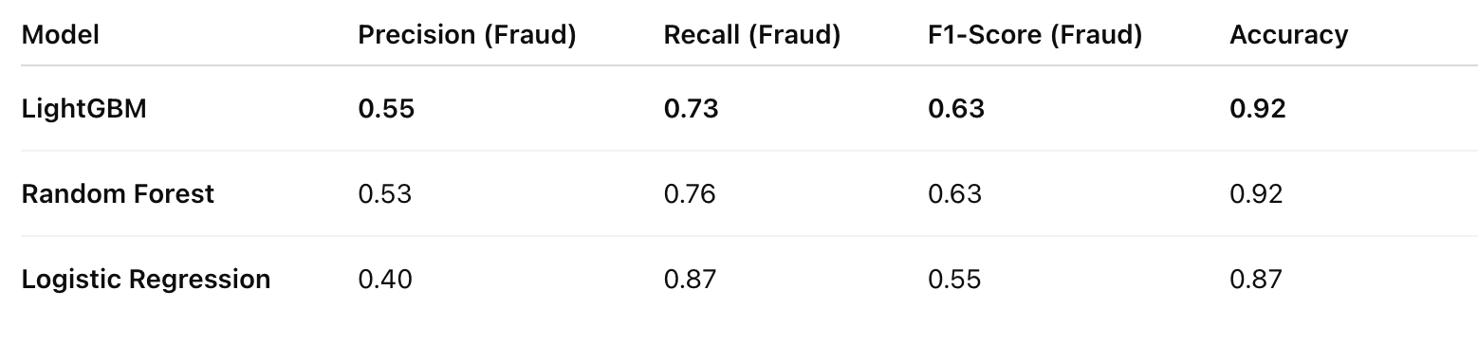
Compare Classification Reports
We compared the classification performance of LightGBM, Random Forest, and Logistic Regression using key fraud-detection metrics:
Precision (Fraud Class – Class 1) Recall (Fraud Class – Class 1)
F1-Score (Fraud Class)
Overall Accuracy
These metrics were extracted from each model’s classification report and organized into a comparison table.
Model Performance Table

Slide 54
ROC Curve Comparison
Precision–Recall Curve Comparison
LightGBM: ROC-AUC = 0.94 (strong discrimination)
Random Forest: ROC-AUC = 0.95
Logistic Regression: ROC-AUC = 0.95
➡️ All models achieve high ROC-AUC, indicating strong ability to distinguish fraud from non-fraud.
LightGBM: PR-AUC = 0.73 → Strong balance between precision and recall
Random Forest: PR-AUC = 0.73 → Similar strong balance
Logistic Regression: PR-AUC = 0.71 → Weaker precision due to false positives
➡️ PR-AUC is most important for imbalanced datasets. ➡️ LightGBM and Random Forest outperform Logistic Regression.

Slide 55
Confusion Matrix Comparison
LightGBM
Correctly identifies most legitimate claims
High fraud recall (captures more true fraud cases)
Slightly more false positives (acceptable in fraud detection)
Random Forest
Balanced performance overall
Slightly fewer fraud detections than LightGBM Fewer false positives, but also fewer true fraud catches
Logistic Regression
Misses more fraud cases than tree-based models
High false-negative rate → riskier for fraud detection
➡️ LightGBM detects the most fraud while maintaining a reasonable error level.

Slide 56
Final Ranking
1️⃣ LightGBM — Best Overall Model
Highest recall & F1 among fraud-focused metrics
Strongest PR-AUC
Excellent ROC-AUC
Best for imbalanced, nonlinear fraud patterns
2️⃣ Random Forest — Strong Runner-Up
Stable and interpretable
Recall slightly lower than LightGBM
Competitive PR-AUC and ROC-AUC
3️⃣ Logistic Regression — Weakest Performer
Underperforms on nonlinear, imbalanced fraud data
High false-negative rate
Lowest precision and F1-score

Slide 57
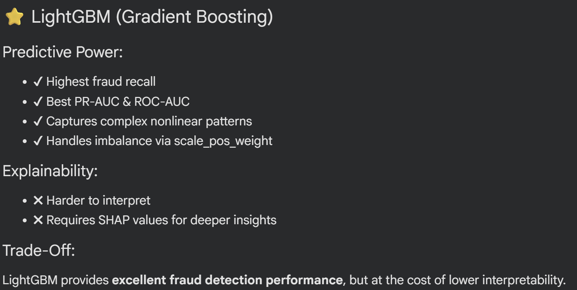
Trade-Off Discussion — Predictive Power vs Explainability

Slide 58
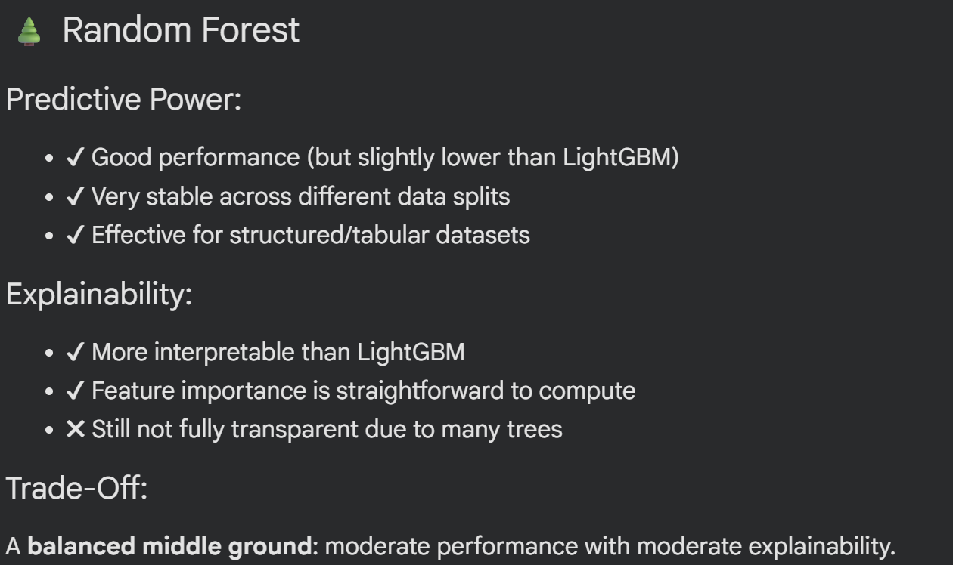
Trade-Off Discussion — Predictive Power vs Explainability

Slide 59
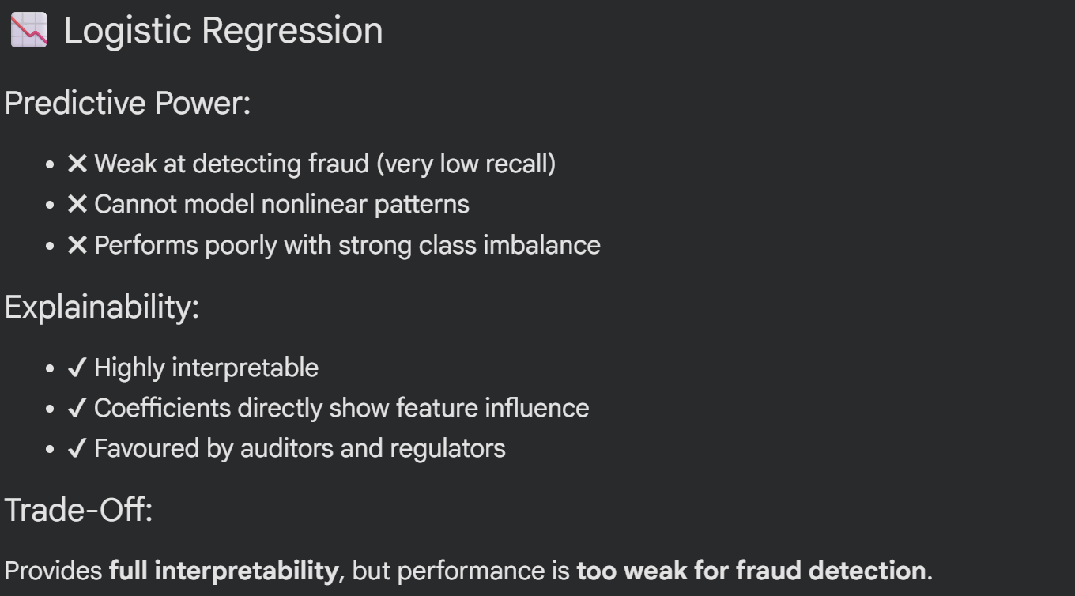
Trade-Off Discussion — Predictive Power vs Explainability

Slide 60
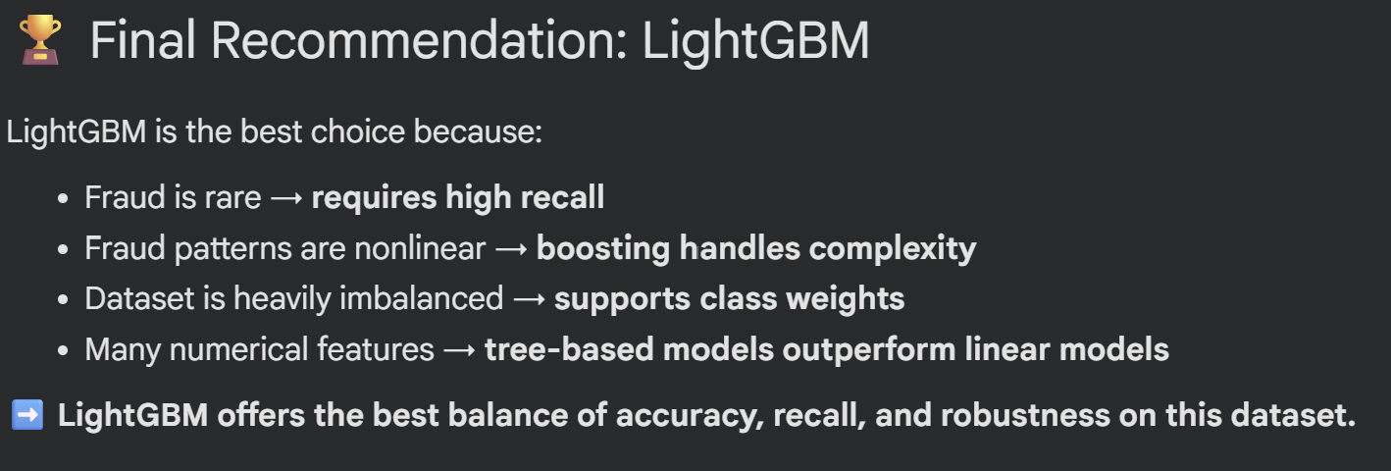

Slide 61
03
Evaluation Metric
Osama Loay
Osama

Slide 62
Train/Test/Validate
Since there was no DateTime like feature we couldn’t apply
Time-based cross-validation
, the data was cross-validated using 60% train , 20% , 20 % validation and test respectively
GroupKFold does not stratify by label. If groups are small (1 sample) or label distribution differs across groups, folds can have very imbalanced or empty positive classes. That breaks metric computation, which is true in our case

Slide 63
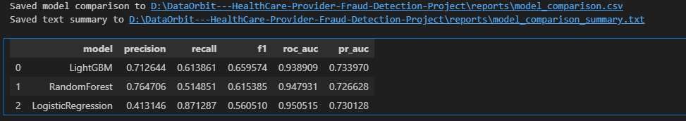
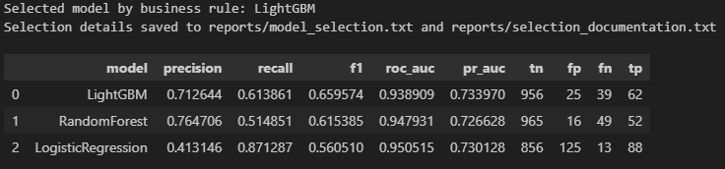
Evaluating Models and performance assessment
Precision – The share of flagged providers that truly belong to the positive (fraud/risk) class. In practical terms: when the model raises a flag, how often is it right?
Recall (Sensitivity) – The fraction of actual positive cases the model manages to capture. Put simply: out of all true fraud cases, how many did we detect?
F1 Score – The harmonic mean of Precision and Recall. It provides a single number that balances both the model’s accuracy in flagging cases and its ability to find them.
ROC-AUC – The area under the ROC curve, reflecting the model’s ability to rank positive cases ahead of negative ones across all possible thresholds. This metric is informative when class imbalance is present but not extreme.
PR-AUC – The area under the Precision–Recall curve, which focuses directly on how the model performs on the positive (minority) class. Because it highlights the quality of predictions where data is sparse, it is generally the more meaningful metric for highly imbalanced problems.
LogisticRegression catches most fraud but triggers too many false alarms. RandomForest keeps false positives low but misses many cases. LightGBM offers the best balance, meeting our recall target with solid precision. We recommend LightGBM and fine-tuning its threshold using the business cost function

Slide 64
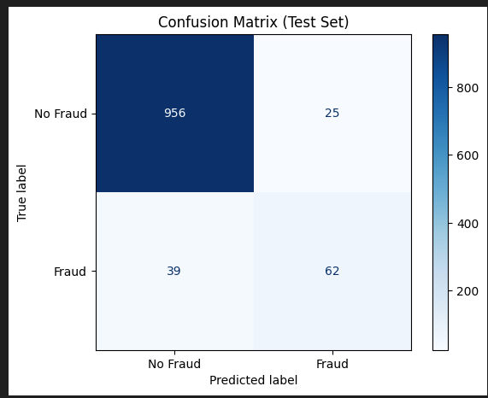
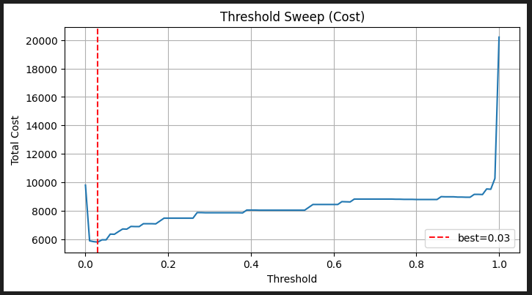
confusion matrix and cost-based analyses
Confusion Matrix for the best model
Cost-based Analyses :
We convert precision and recall into “per 100 fraud cases” so stakeholders can see the real trade-offs: investigations vs. missed losses.
Using C_FP = $10 and C_FN= $200,
Findings & Implications:
LogisticRegression has the lowest cost but would overload the investigation team. RandomForest keeps investigations low but misses too much fraud. LightGBM strikes the best balance and meets our recall target. We recommend using LightGBM as the baseline, tuning its threshold with a cost sweep, and running a small pilot to confirm real-world impact.
Coast sweep

Slide 65
Error Analyses and Model Limitations
FP/FN Case Study — Key Insights & Fixes
Why errors happen: FPs come from legitimate outliers lacking context (specialty, contracts, payer mix), while FNs stem from subtle or distributed fraud patterns that static provider-level features cannot capture.
What’s missing: No temporal or network signals to detect shifts or coordinated behavior; limited labels for certain fraud modes; LightGBM overly sensitive to feature extremes.
How to improve: Add temporal + network features, enrich contextual fields, use SHAP to target failure patterns, apply cost-based thresholding, and consider an anomaly-detection branch for coordinated activity.

Slide 66
False Positive Examples (Predicted Fraud, Actually Legitimate)
PRV55850
Predicted probability: 0.985 → flagged as fraud
Features: MaxMonthlyReimbursement = 108,840; AvgAge = 71; InpatientReimbursement = 348,000
Takeaway: High reimbursement values and older patient populations caused the model to misclassify these legitimate providers as fraud.
PRV51285
Predicted probability: 0.985 → flagged as fraud
Features: MaxMonthlyReimbursement = 57,050; AvgAge = 73; InpatientReimbursement = 161,000

Slide 67
False Negative Examples (Missed Fraud)
PRV55850
Predicted probability: 0.985 → flagged as fraud
Features: MaxMonthlyReimbursement = 108,840; AvgAge = 71; InpatientReimbursement = 348,000
Takeaway: High reimbursement values and older patient populations caused the model to misclassify these legitimate providers as fraud
PRV51285
Predicted probability: 0.985 → flagged as fraud
Features: MaxMonthlyReimbursement = 57,050; AvgAge = 73; InpatientReimbursement = 161,000

Slide 68
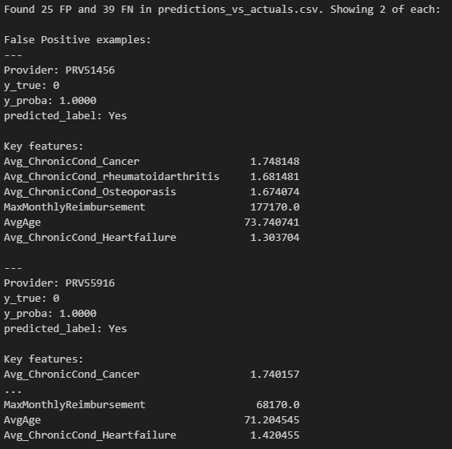

Slide 69
Thanks!

